Slide 1
OUTLINE
Abstract
Introduction
Literature Survey
Existing System
Proposed System
System Requirements
System Architecture
UML Diagrams
Modules
Implementation
Expected Outcomes
References

Slide 2
ABSTRACT
This project presents an automated system for detecting surface defects on Printed Circuit Boards (PCBs) using the YOLOv8 deep learning model. Traditional PCB inspection methods are manual and error-prone, especially in dense and complex circuits. The proposed system uses a trained object detection model to identify and localize six common PCB defects in real time. A desktop application integrates the trained model to provide visual inspection, defect classification, and count analysis. Experimental evaluation demonstrates high precision and reliable performance, making the system suitable for academic and industrial demonstration of automated PCB quality control.

Slide 3
INTRODUCTION
Printed Circuit Boards (PCBs) are the foundation of all modern electronic devices, serving as the platform that connects and supports electronic components. Even minor defects in PCBs can lead to product malfunction, reduced performance, or complete system failure. Traditionally, PCB defect detection has relied on manual inspection or rule-based machine vision techniques, which are time-consuming, prone to human error, and unsuitable for high-speed production environments. With the growth of artificial intelligence and deep learning, automated defect detection has become more efficient and accurate. Among various object detection models, the YOLO (You Only Look Once) algorithm stands out for its real-time performance and high precision. This project focuses on applying the YOLOv8 architecture for accurate and real-time detection of PCB defects to enhance the detection of complex and irregular PCB defects, ensuring higher reliability, speed, and adaptability in industrial quality control processes.

Slide 4
LITERATURE SURVEY
S.NO | Titles | AUTHOR | DESCRIPTION | YEAR
1 | Wavelet Transform-Based PCB Defect Detection and Localization | Ibrahim | Proposed an algorithm using wavelet transform for PCB defect detection, reducing computation time but limited by lighting and environment variations | 2018
2 | You Only Look Once (YOLO): Unified Real-Time Object Detection | Redmon | Introduced the YOLO algorithm for real-time object detection, forming the foundation for later PCB defect detection models | 2016
3 | C2Focal Module for Dense PCB Defect Detection | Ling | Developed a CNN-based model with the C2Focal module to integrate local and global features, improving detection on dense PCB layouts | 2022
4 | Improved YOLOv8 with Shape-IoU and Dual Attention for PCB Inspection | Zhang | Enhanced YOLOv8 by adding a dual-layer routing attention mechanism and Shape-IoU loss for better accuracy and defect shape handling. | 2024

Slide 5
EXISTING SYSTEM
The existing PCB inspection process relies heavily on manual visual inspection or traditional rule-based machine vision systems. These approaches are time-consuming, prone to human error, and ineffective in handling dense PCB layouts and small defects. Manual inspection becomes unreliable in high-speed production environments, leading to missed defects and inconsistent quality control.
Disadvantages:
Manual inspection is slow and labor-intensive
High chance of human error, especially for tiny defects
Performance depends on operator skill and fatigue
Not scalable for high-speed production
Traditional rule-based vision systems fail on complex PCB layouts

Slide 6
PROSPOSED SYSTEM
The proposed system introduces an automated PCB inspection framework using the YOLOv8 deep learning model. PCB images are processed by a trained object detection network that identifies and localizes six common defect types. A desktop application integrates the trained model, allowing users to load PCB images, visualize predictions, zoom into defect regions, and obtain defect counts in real time. This approach improves inspection speed, accuracy, and reliability while reducing human dependency. mAp (mean average precision).
Regarding the model performance we have Precision (P) : 0.904, Recall (R) : 0.797, mAP@0.5 : 0.871,
mAP@0.5–0.95 : 0.451

Slide 7
ADVANTAGE
Time-saving: Automates manual tasks and speeds up data processing.
Accuracy: Minimizes human errors through automated data entry and validation.
Centralized database: Ensures all information is stored in one secure location.
Data security: Role-based access control protects sensitive information.
Easy data retrieval: Users can quickly search, view, and update records.
Improved communication: Enhances coordination between departments and user

Slide 8
SYSTEM REQUIREMENTS
HARDWARE REQUIREMENTS:
System : Intel Core i5 or higher
Hard Disk : 500 GB or more
Monitor : 15” LED Monitor
Mouse : Optical Mouse
RAM : 8 GB
Graphics (Optional) : NVIDIA GPU with CUDA support (for deep learning tasks)

Slide 9
SYSTEM REQUIREMENTS
SOFTWARE REQUIREMENTS:
Operating System : Windows 10 / Ubuntu 20.04+
Programming Language : Python 3.9+
Deep Learning Framework : Ultralytics YOLOv8, PyTorch
Libraries : OpenCV, NumPy, Pillow, Tkinter
IDE / Tools : VS Code, Jupyter Notebook, Google Colab

Slide 10
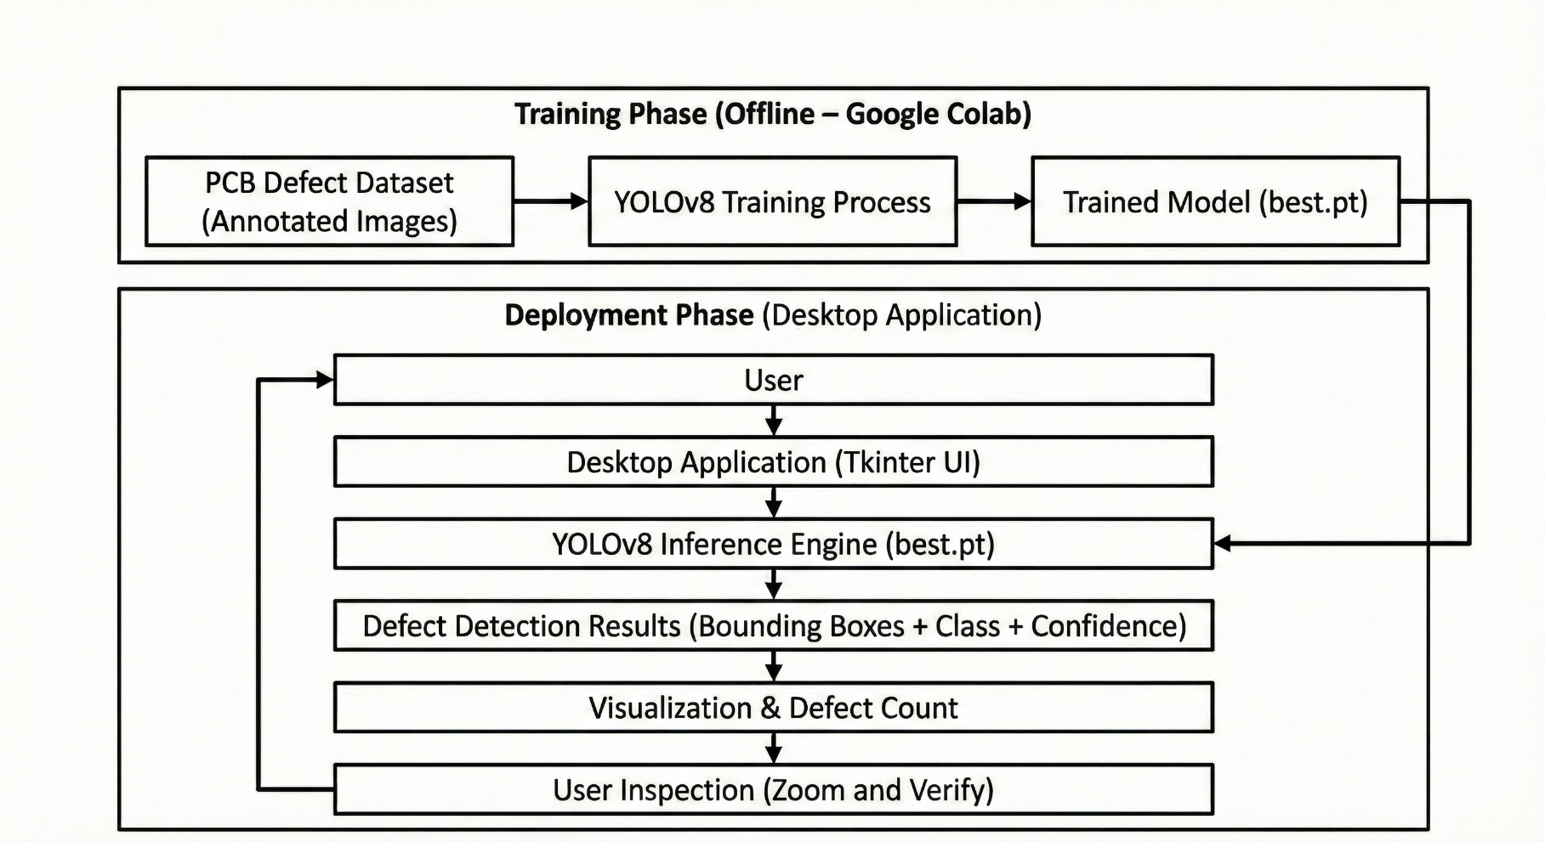
SYSTEM ARCHITECTURE

Slide 11
UML DIAGRAMS
Unified Modeling Language (UML) diagrams are used to visually represent the structure and behavior of the system. They help in understanding how different components interact, how data flows, and how users communicate with the application. In this project, UML diagrams such as Use Case, Sequence, Class, Flow Chart, and Data Flow Diagrams are used to clearly illustrate the workflow, system architecture, and relationships between modules.

Slide 12
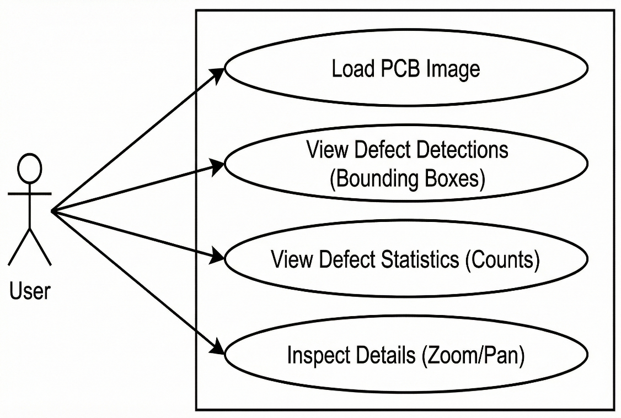
Use Case Diagram
This diagram defines the functional scope of the application from the user's perspective, mapping out the specific actions an operator can perform. It highlights the core interactions, such as Loading a PCB Image, Viewing Detection Results, and checking defect statistics. Additionally, it includes the essential inspection utilities, showing how the user accesses Zoom and Pan controls to verify the model’s findings on the board.

Slide 13
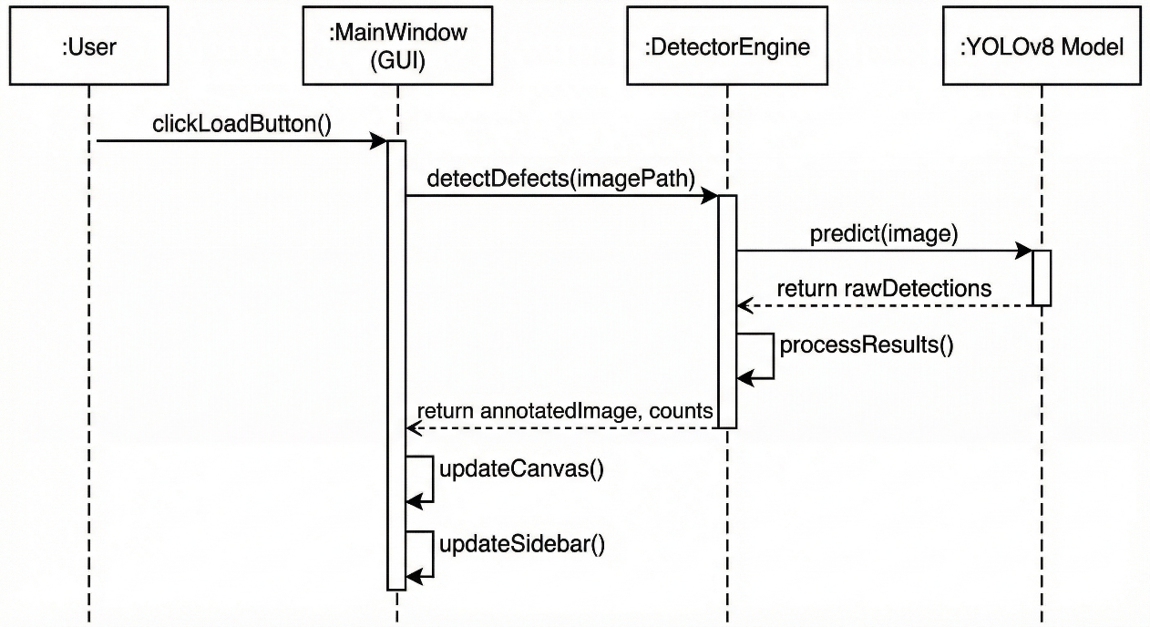
Sequence Diagram
The Sequence Diagram details the chronological timeline of interactions between the User, the GUI, and the backend logic. It begins when the user triggers the "Load Image" event, which prompts the application to send the file path to the Detector Engine. The engine then requests a prediction from the YOLOv8 Model, receives the raw defect data, and passes it back to the interface to immediately render the bounding boxes on the screen.

Slide 14
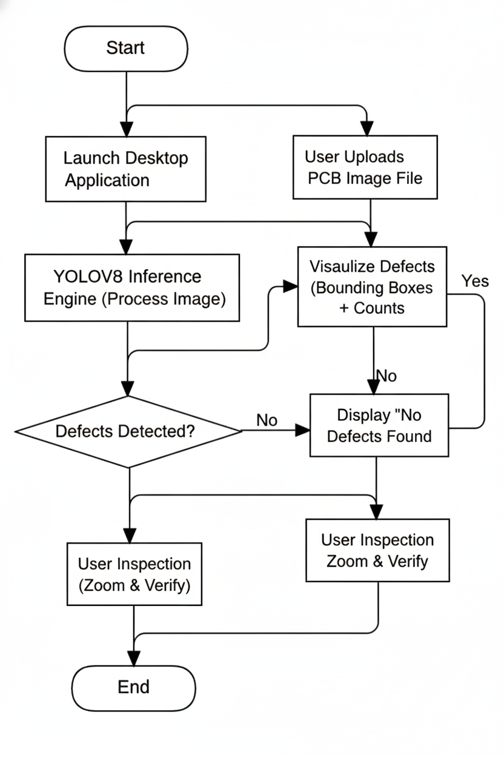
Flow Chart Diagram
Logic Flow:
Input: User loads a PCB image into the desktop app.
Processing: The image is passed to the YOLOv8 Engine for analysis.
Decision: The system checks if any of the 6 defect types are present.
If Yes: Draws bounding boxes and updates counts.
If No: Displays a "Clean Board" status.
Verification: User manually inspects the results using Zoom/Pan controls.

Slide 15
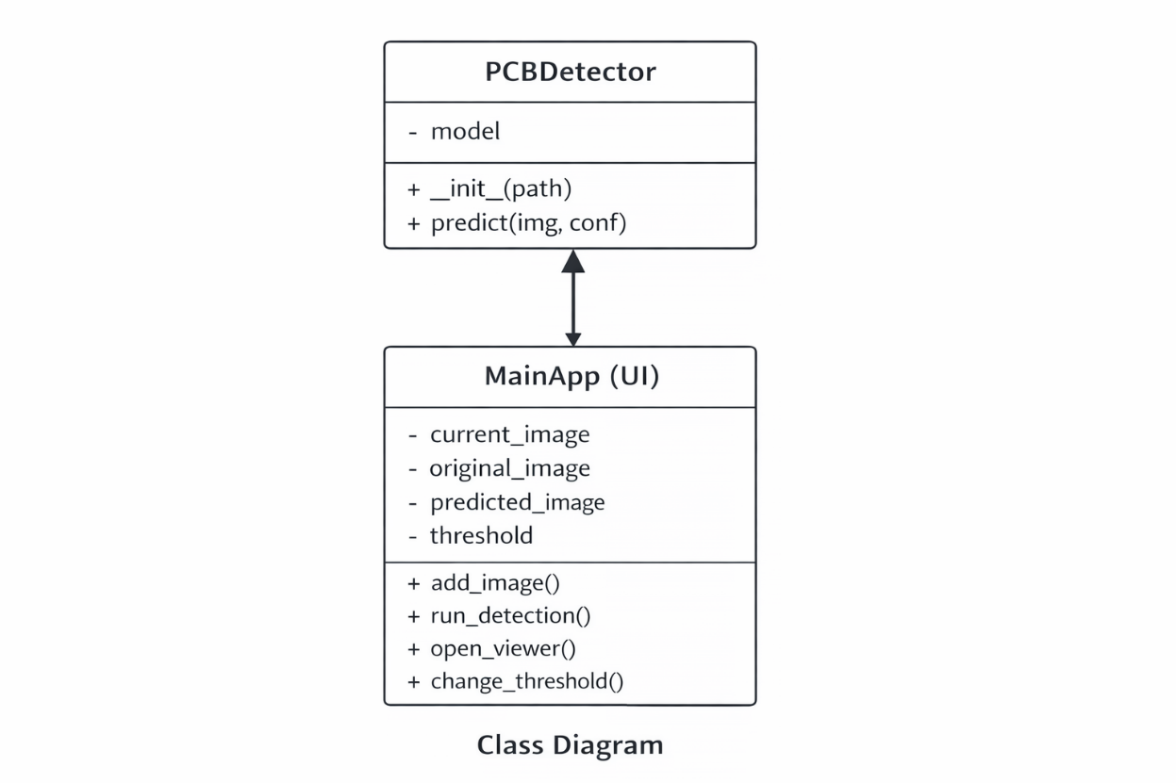
Class Diagram
The class diagram shows the two main components of the system: the user interface and the detection engine. The MainApp class handles user actions such as loading images and displaying results, while the PCBDetector class manages the YOLOv8 model and performs defect detection. MainApp interacts with PCBDetector to obtain predictions and visualize them. This structure keeps the interface and detection logic separate, making the system simple, modular, and easy to maintain.

Slide 16
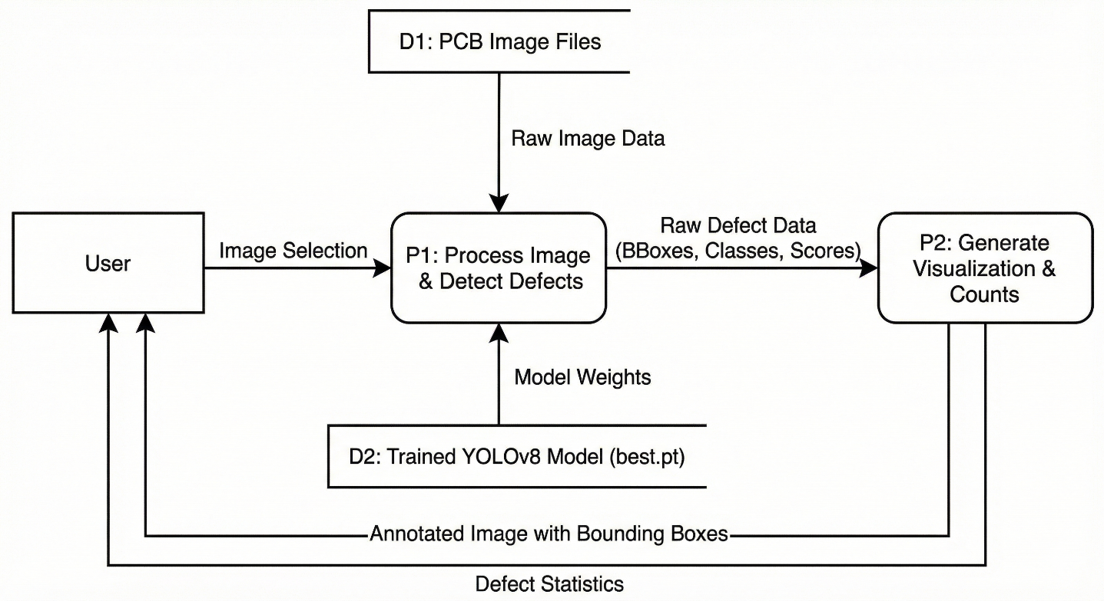
Data Flow Diagram
The Data Flow Diagram illustrates how information moves from the initial input to the final result. Raw image data flows from the user into the YOLOv8 Processing Unit, which accesses the trained model file (best.pt) to generate defect coordinates. These raw predictions are then passed to the Visualization Engine, which transforms them into the final annotated image and defect statistics displayed on the screen.

Slide 17
MODULES
USER
DEEP LEARNING

Slide 18
USER
This module allows users (such as technicians or inspectors) to interact with the system. Users can run the application, upload image from test_data folder or also can directly add image clicked by the camera and add to prediction. They can view the prediction results along with the confidence level of classification.
Features:
Image Upload
Prediction Display with Confidence Score
View Model Accuracy Metrics

Slide 19
Deep learning
This module handles training and inference of the YOLOv8 model. The PCB defect dataset is loaded and preprocessed, and the model is trained using annotated images. During inference, the trained model detects defect regions, classifies defect types, and returns bounding boxes with confidence scores.
Features:
Dataset loading and labeling
Image preprocessing and augmentation
YOLOv8 model training
Defect detection and localization
Confidence-based prediction

Slide 20
IMPLEMENTAION
Main.py:
from tkinter import *
from tkinter import ttk, filedialog
from PIL import Image, ImageTk
import os
import cv2
from detector import PCBDetector
BASE_DIR = os.path.dirname(os.path.abspath(__file__))
MODEL_PATH = os.path.join(BASE_DIR, "../models/best.pt")
INIT_IMG = os.path.join(BASE_DIR, "../assets/whitebg.jpg")
detector = PCBDetector(MODEL_PATH)
current_image_path = None
original_pil = None
predicted_pil = None
score_thresh = 0.5
def open_viewer(pil_image, title):
if pil_image is None:
return
win = Toplevel(root)
win.title(title)
win.geometry("900x700")
canvas = Canvas(win, bg="lack")
zoom = 1.0

Slide 21
def redraw():
nonlocal img, zoom
w, h = img.size
resized = img.resize((int(w * zoom), int(h * zoom)))
t k = ImageTk.PhotoImage(resized)
canvas.image = tk
canvas.delete("all")
canvas.create_image(0, 0, anchor="nw", image=tk)
canvas.config(scrollregion=canvas.bbox(ALL))
def on_mousewheel(event):
nonlocal zoom
if event.delta > 0:
zoom *= 1.1
else:
zoom /= 1.1
redraw()
def start_pan(event):
canvas.scan_mark(event.x, event.y)
def do_pan(event):
…
ttk.Button(control, text="Add Image", command=add_image).grid(row=row_base + 3, columnspan=2, pady=5)
ttk.Button(control, text="Run Detection", command=run_detection).grid(row=row_base + 4, columnspan=2, pady=5)
root.mainloop()

Slide 22
Detector.py:
from ultralytics import YOLO
import cv2
class PCBDetector:
def __init__(self, model_path):
self.model = YOLO(model_path)
def predict(self, image_path, conf=0.5):
results = self.model(image_path, conf=conf)[0]
img = cv2.imread(image_path)
label_map = {
"missing_hole": "Missing Hole",
"mouse_bite": "Mouse Bite",
"open_circuit": "Open Circuit",
"short": "Short Circuit",
"spur": "Spur",
"spurious_copper": "Spurious Copper"
}
counts = {v: 0 for v in label_map.values()}
for box in results.boxes:
cls = int(box.cls[0])
raw_name = results.names[cls]
ui_name = label_map.get(raw_name, raw_name)
…
cv2.putText(img, ui_name, (x1, y1 - 5),
cv2.FONT_HERSHEY_SIMPLEX, 0.5, (0, 255, 0), 2)
return img, counts

Slide 23
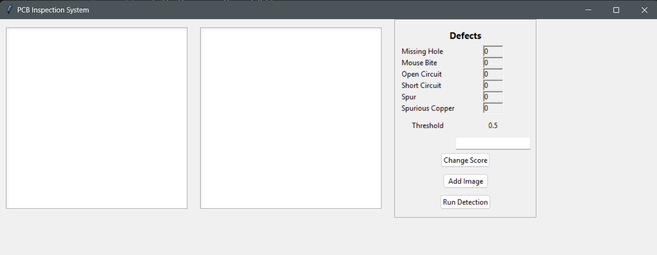
EXPECTED OUTCOMES
Initial interface of the application

Slide 24
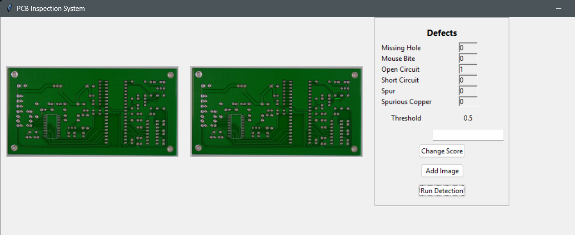
Adding the image and running the model on it.

Slide 25
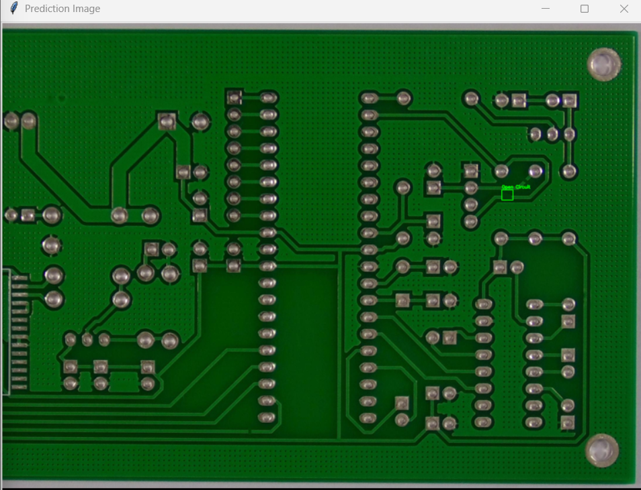
Visualizing the defect

Slide 26
REFERENCES
Ling Q, Isa N A M, Asaari M S M. Precise detection for dense PCB components based on modified YOLOv8. IEEE Access, 2023.
Redmon J. You only look once: Unified, real-time object detection.
Laroca, Rayson, et al. ”A robust real-time automatic license plate recognition based on the YOLO detector
Terven J, Cordova-Esparza D M, Romero-Gonz ´ alez J A. A comprehen- ´ sive review of yolo architectures in computer vision: From yolov1 to yolov8 and yolo-nas

Slide 27
CONCLUSION
The system is designed to accurately identify and localize different types of PCB defects, minimizing the need for manual inspection and overcoming the limitations of traditional rule-based systems and visualization on new images, and integration of advanced techniques such as Shape-IoU loss for improved bounding box precision and attention mechanisms for detecting small or overlapping defects. Experimental results show that the model achieves high accuracy and reliable performance even in complex or noisy conditions.

Slide 28
THANK YOU

